Slide 1
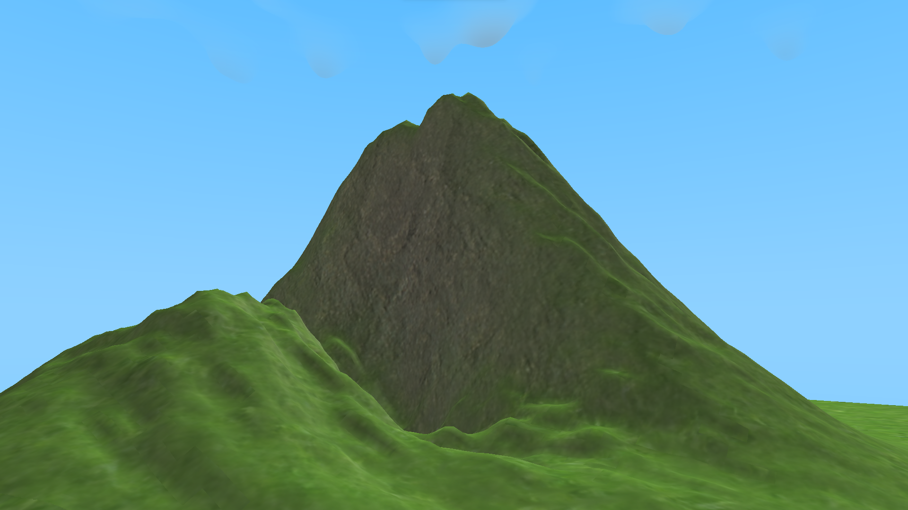
Pycraft
Play
Credits
Settings
Achievements
Character Customisation

Slide 2
Pycraft
Play
Credits
Settings
Achievements
Character Customisation

Slide 3
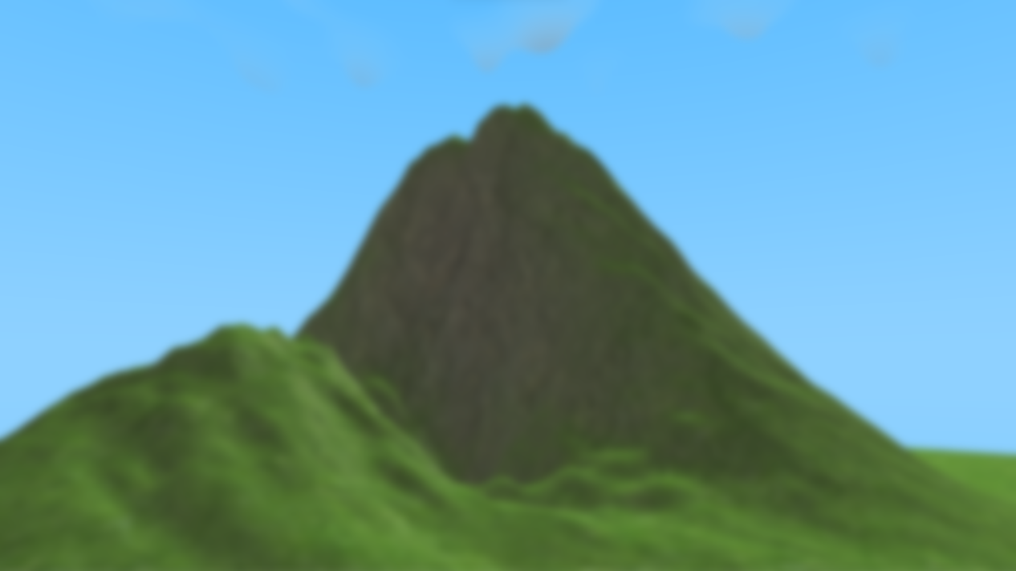
Pycraft
Play
Credits
Settings
Achievements
Character Customisation

Slide 4
Pycraft
Play
Credits
Settings
Achievements
Character Customisation

Slide 5
1st decision
2nd decision
3rd decision
4th decision
3 total ‘mistakes’
START
2 total ‘mistakes’
1 total ‘mistake’
Ideal solution
0 total ‘mistakes’

Slide 6

Pycraft

Slide 7
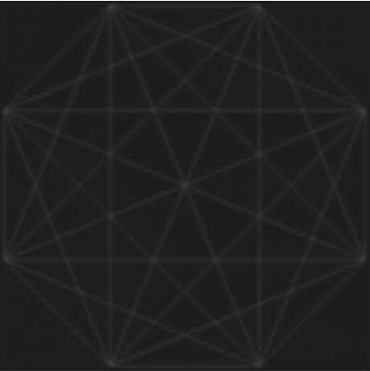


Slide 8

Pycraft

Slide 9

Pycraft

Slide 10
Pycraft

Slide 11


Slide 12


Slide 13

#
PycraftDev

Slide 14
#
PycraftDev

Slide 15


Slide 16
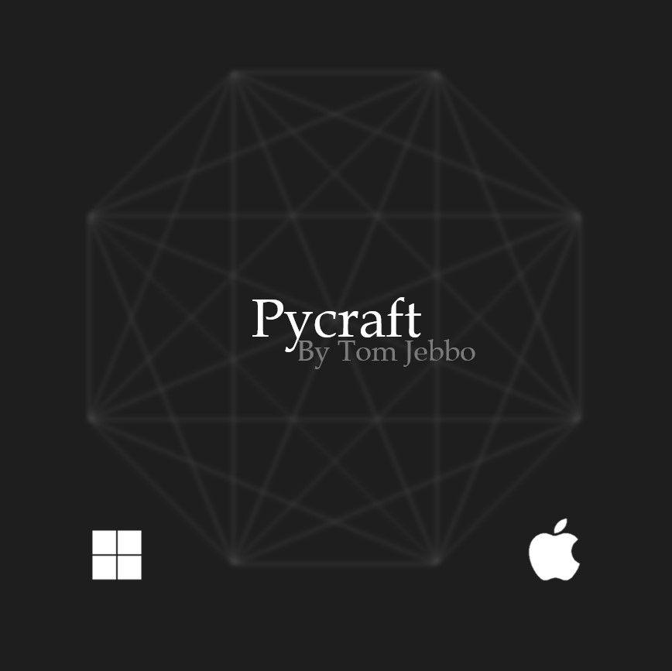

Slide 17
Pycraft
By PycraftDev

Slide 18



Slide 19
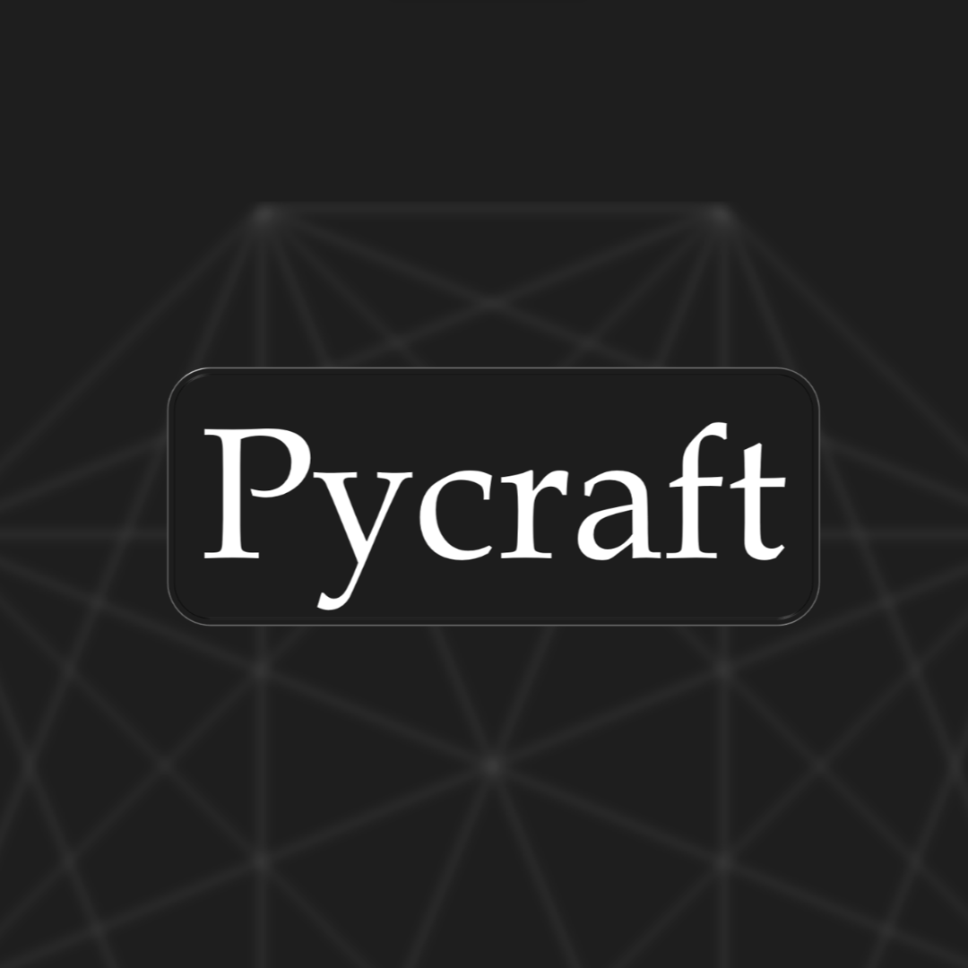

Slide 20

P

Slide 21

Pycraft

Slide 23


